Slide 1
BDSN End Term Assignment (Machine Learning with Python and Spark) Car Price Prediction Using Regression
Name- Ayan Mullick
Roll No.- C22006

Slide 2
Business Problem
In automobile industry price of new cars in the industry are fixed by the manufacturer with large amount of taxes additionally incurred by the Government. For the shortage of semiconductor globally price of new cars is increasing and no of cars manufactured by company is also less. For that average delivery time for new selling car is increasing so, customers are more preferred to buy used cars rather than new one for short time purchase. Also increasing price of new cars and the incapability of customers to buy new cars due to the lack of funds, used cars sales are heavily increase on an Indian market. As per reports from Auto car India, for year 2022, the count of old car users has been increased massively in India.

Slide 3
Research Objective
For the given dataset we have to predict the target feature ‘Selling Price’ for different cars having different features. For this prediction we have to build up a machine learning model. Along with that some general analysis based on the features are also required to be conducted.

Slide 4
Dataset Description
The dataset is taken from Kaggle and it has some details of different cars.
Total number of features is 8 and total number of instances are 4340.
The columns are: ‘name’, ‘year’, ‘km_driven’, ‘fuel’, ‘seller_type’, ‘transmission’, ‘owner’, ‘selling_price’.
I have to predict ‘selling_price’ which is continuous in nature. So the problem is a regression problem.

Slide 5
Data Extraction from GitHub
Wget is a networking command-line tool that lets you download files and interact with REST APIs. Its a URL network downloader that can work in the background, and it helps in downloading files directly from the main server.

Slide 6

Converting the Data Frame into Dictionary
o_dict() method is used to convert a data frame into a dictionary of series or list like data type depending on orient parameter.
Parameters: orient: String value ('dict', 'list', 'series', 'split', 'records', 'index') Defines which dtype to convert Columns(series into).
The type of the key-value pairs can be customized with the parameters.

Slide 7
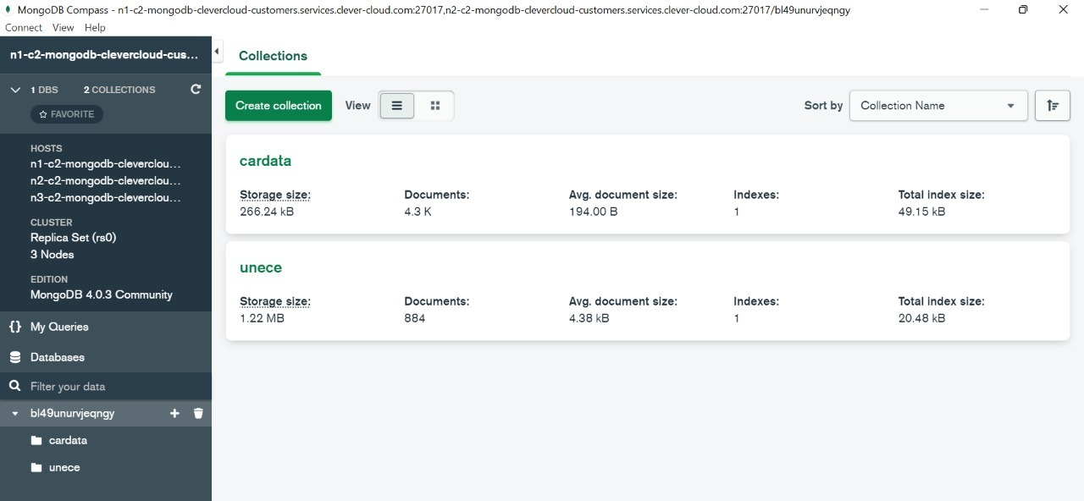
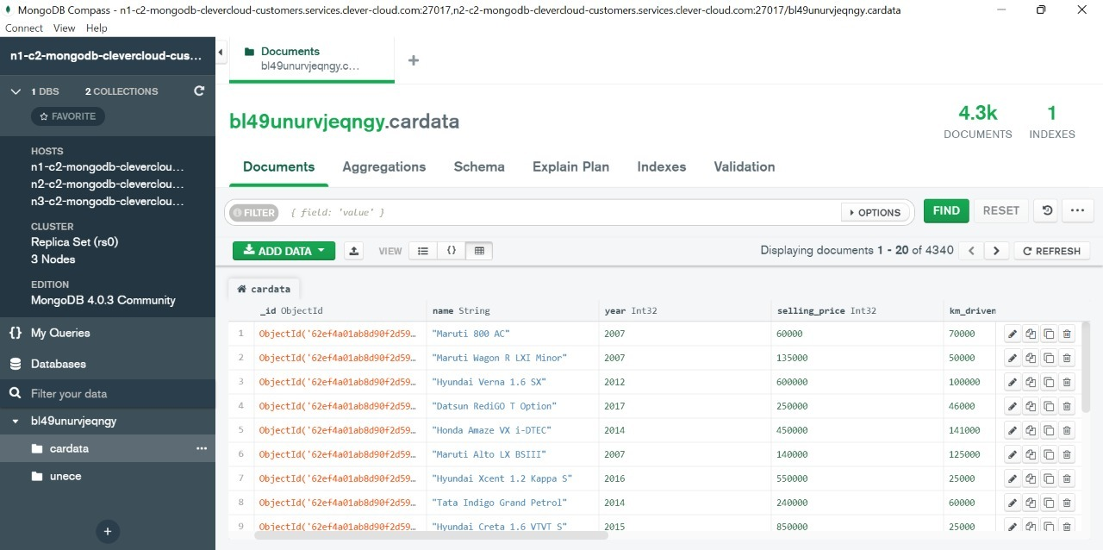
Uploading Data in MongoDB Compass
In existing database ‘bl49unurvjeqngy’ created a new collection name as a cardata and uploaded the dataset which was in json file format.

Slide 8
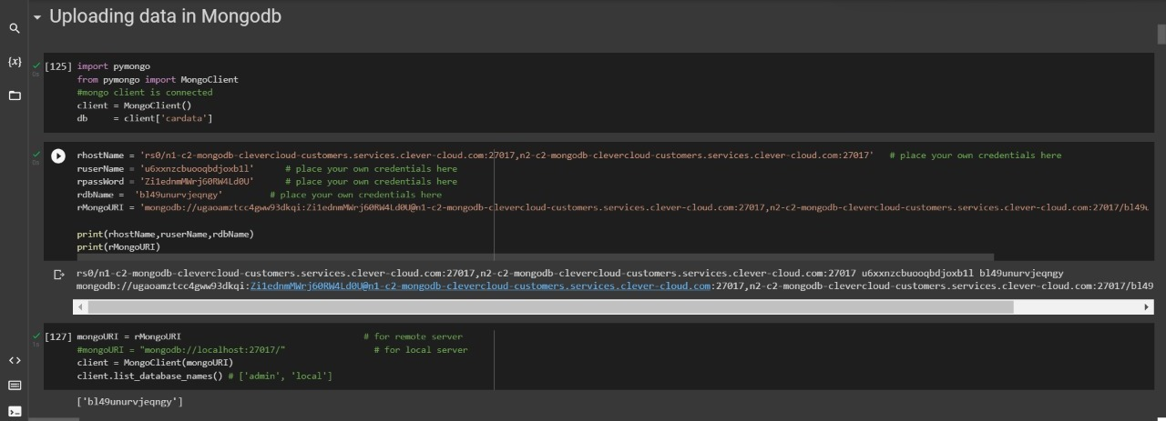
Data in MongoDB using Clever Cloud

Slide 9
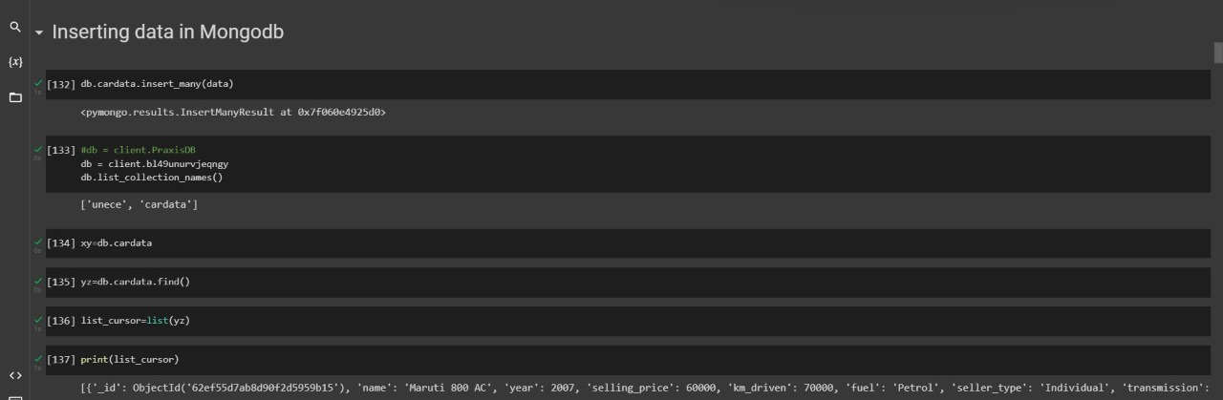
Inserting Data in MongoDB

Slide 10
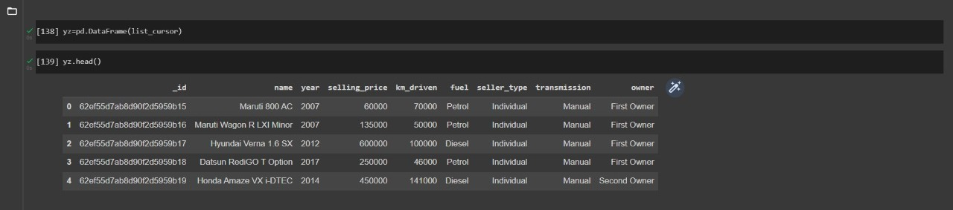
Converting the Data into Pandas Dataframe
It creates a Data Frame object from a structured ndarray, sequence of tuples or dicts, or Data Frame.

Slide 11
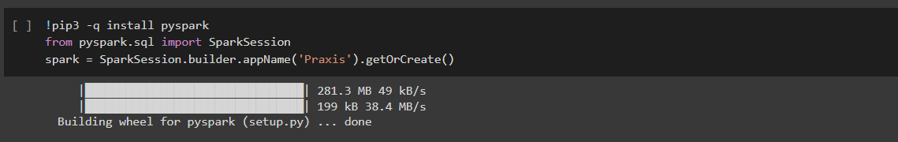
Installation of PySpark
pip3 is the official package manager and pip command for Python 3. It enables the installation and management of third-party software packages with features and functionality not found in the Python standard library. Pip3 installs packages from PyPI (Python Package Index).
PySpark is the Python API for Apache Spark, an open source, distributed computing framework and set of libraries for real-time, large-scale data processing.

Slide 12
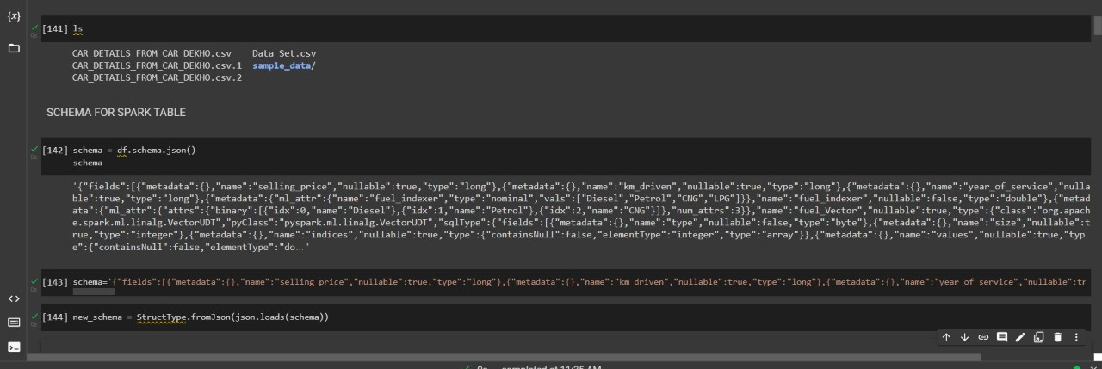
Loading Data using Spark

Slide 13
Data Attributes
Numerical type of attributes: year, selling_price, km_driven
Categorical type of attributes: name, fuel, seller_type, transmission, owner
The dataset has been read as a spark dataframe from a csv file with the help of below command:

Slide 14
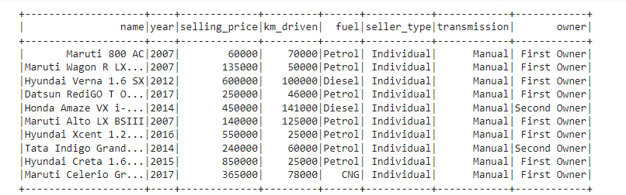
Dataset Snapshot
Below is the first 10 rows of the dataframe ‘data’:

Slide 15
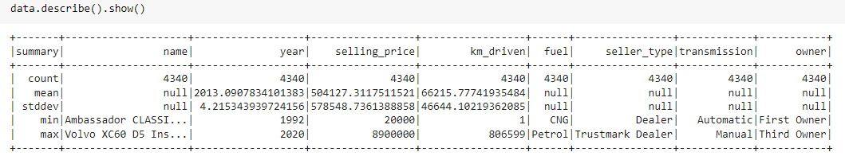
Summary Statistics
Summary of the dataset consists of 5 properties: count, mean(average), stddev(standard deviation), min, max:
As 'name', 'fuel', 'seller_type' and 'transmission' are all categorical attributes so they don't have mean and standard deviation, as a result in summary for the mentioned attributes these particular things are null.

Slide 16
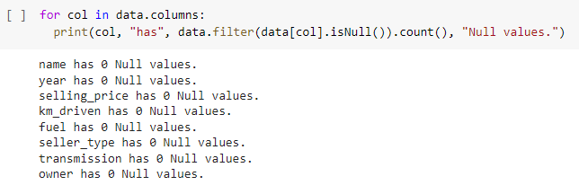
Data Exploration
The dataset doesn’t have any null value. Below is its proof.

Slide 17
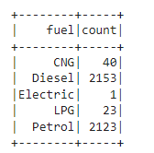
Exploratory Data Analysis
Analysis:
As the number of instance with 'Electric' as fuel is only 1 so we can't keep it because it won't help in random split of the data because this instance will go to either in train set or test set. So after training the model it can create problem for prediction.
Showing Group wise count:
Based on the categories of ‘Fuel’ attribute:

Slide 18
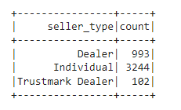
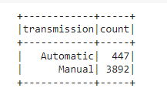
Analysis on Seller_Type and Transmission
Below is the count of each category of seller_type.
Only 3 types of seller are present
Below is the count of each category of Transmission.
Transmission is of 2 types.

Slide 19
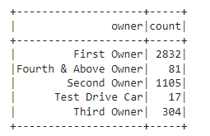
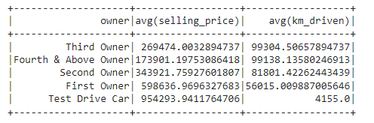
Analysis based on Owners:
There are 5 types of owners and below is their count.
Below is the average selling price and km_driven based on owner.

Slide 20
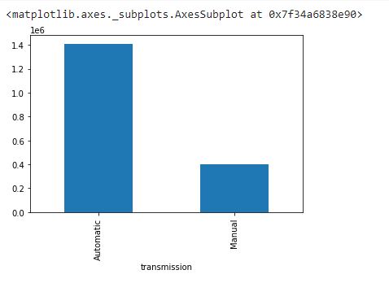
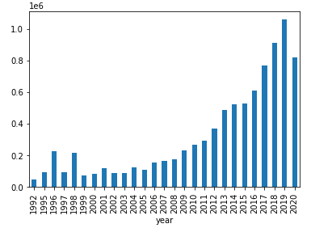
Visualization based on Transmission and Year
Cars with Automatic transmission has higher average selling price.
with increasing year the selling price of a car has been increased gradually or in other words, the car with highest year of service has lowest selling price i.e., the oldest car has lowest selling price

Slide 21
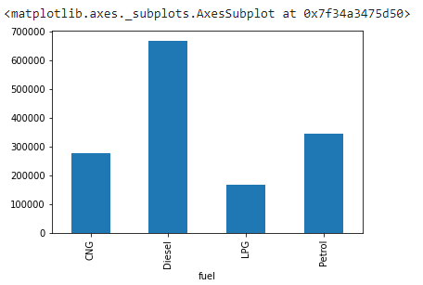
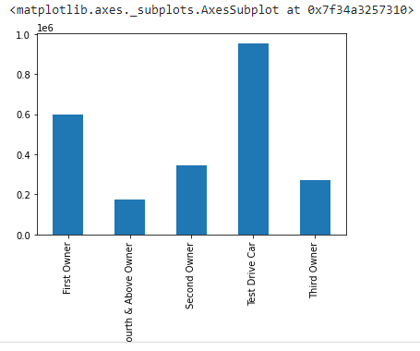
Visualization based on Fuel and Owner:
Average Selling_price based on Owner:
Test Drive Car has the highest average selling price . Looking at the variation it can be said that this attribute can be a good predictor
Average Selling_Price based on Fuel:
We can see that Average selling price is highest for fuel Diesel. Looking at the variation it can be said that this attribute can be a good predictor

Slide 22
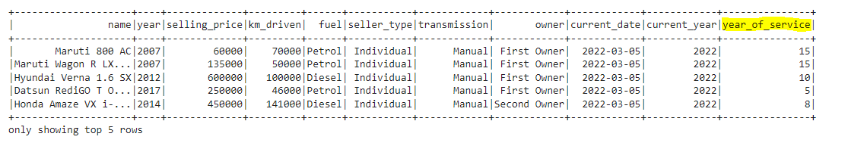
Feature Engineering on year column:
In this dataframe ‘year’ column is numerical with ‘int’ datatype. But a new column has been added to define ‘year_of_service’ .
The formula is: year(current_date) - year

Slide 23
Preprocessing on the Data:(Categorical attributes)
For Preprocessing we had to handle the numerical and categorical data separately.
For all the categorical data the preprocessing consists of 2 steps:
String Indexing
OneHot Encoding
Both have to be downloaded from the pyspark.ml.feature. These two pre-processors are used for converting the categorical attributes in OneHot encoded vectors. Then vector assembler is used for assembling these two separate vectors . One thing is to be notified here : The output of string indexer works as input of OneHot Encoder. So for each and every categorical attribute we have to apply these two pre-processors separately.

Slide 24
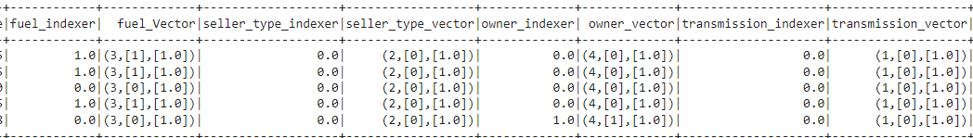
String Indexer and One-hot Encoder
String Indexer encodes the string column of labels to a column of label indices. It is used to perform the task of ordering.
One Hot Encoder is used for converting the categorical columns to numerical columns or numeric vector which the ML models can understand.
In the picture fuel_vector, seller_type_vector, owner_vector, transmission_vector are the results of One hot Encoding.

Slide 25
Preprocessing on the Data: Numerical Attributes)
For Numerical attributes we can use Standard Scaler for bringing all the numerical attributes to the same scale.
Standard Scaler is also imported from pyspark.ml.feature.
All the preprocessed results are then combined with the help of Vector Assembler. Generally we don’t keep all the attributes separately. We keep all the features together and name them as feature and along with that the label is also kept which are fitted to the model for training.

Slide 26
Train-Test Split
Before fitting the model we normally split our data into train and test .
Normally we use random split and split our data into 70% and 30% data where 70% is used for training our model and 30% is for validation.

Slide 27
Training – Testing- Prediction- Evaluation
As it’s regression problem so I have used Linear Regression Model which have been imported from pyspark.ml.regression library.
We fit our model to the train set that we create through the train test split.
After fitting the model we use it to predict the test set.
As a evaluation metric we use Root Mean Square Error and R2 Score . The Root mean square error should be as low as possible along with that the R2 score should be as high as possible to prove the good fit of the model.
In my project I got R2 score as 0.47948 i.e, approximately 0.48. So , here we can say that the built model can express 48% of the variability of the entire target feature.

Slide 28
Conclusion
After the prediction the score is not that good, as a result I can’t say that the model is one of the best model. But it can be further using some other algorithms. It is also found sometimes that always the perfect linear relationship is not always obeyed among the features. So we can try some non-linear model here.

Slide 29
Thank you

